Slide 1
Daily Works 9.19.16

Slide 2
Daily Work 9.19.16
Objectives: Students will be able to demonstrate understanding of dichotomous keys
Science stems
Daily Work…next slide
Review puzzle, How to use Dichotomous keys, Alien Dichotomous key- catch- up
Table of contents and glue in
Book work- go over as a class
Test retakes will be Friday

Slide 3
Daily work 9.19.16….p 37
After making a hypothesis, a scientist must
Analyze the results
Test it with experiments
Share it with other scientists
Draw conclusions
1. After making a hypothesis, a scientist must…
2. A student designs an experiment to determine how surface type affects the amount of force needed to roll a ball 20 meters. What is the independent variable?
The lengths of the surfaces
The force needed to roll the ball
The type of surfaces used
The type of ball chosen
2. The independent variable is ___________________ because __________________.
3. What lab tool would the student need to use for question #2?
3. The lab tools the student should use is a _________________________.

Slide 4
4
4. After they design the dam the engineers should…..
5
5. The procedure that would best verify the program would be….

Slide 5
9.20.16
Objective: Students will be able to demonstrate their understanding of dichotomous keys
Update Table of contents
Daily Work
Make-up work: puzzle, alien dichotomous key, Notes
Dichotomous key, lab tools, SM quiz this Thursday,
Make-Up Day on Friday
Test Next Thursday

Slide 6
Daily work 9.20.16….p. 37
1. Which of these best describes why an artificial arm is considered an assistive engineered product?
It is an adaptation of an earlier technology.
It helps a person with a disability overcome a handicap
It resembles a human body part.
It causes a permanent change to an organism.
1. An artificial arm is considered assistive because….
2. The main biofuel on the market today is ethanol, a fuel made from corn. Which type of bioengineered product is ethanol?
Adaptive
Assistive
Resistant
Manipulated
2. Ethanol, a fuel made from corn is ….

Slide 7
9.20.16
3. Ethanol is being added to gasoline in an attempt to reduce fossil fuel usage. Which is an unintended consequence of ethanol use?
Cost of corn products increases
Improvements in gas mileage
Conservation of fossil fuels
Improved health of the environment
3. An unintended consequence of ethanol use is…
4. A technology company has identified the need for smaller, longer-lasting batteries to use in hybrid vehicles. What would be the first step the engineers should do?
Test the new battery
Reshape the existing battery
Research current battery technology
Build a prototype battery
4. The first step the engineers should do is….

Slide 8
9.21.16---TEAM DAY
Objectives: Students will be able to demonstrate their understanding of dichotomous keys
Weird facts, pages 25 and 26
Review puzzle, Alien dichotomous key, Glue inn
Daily Work
Notes

Slide 9
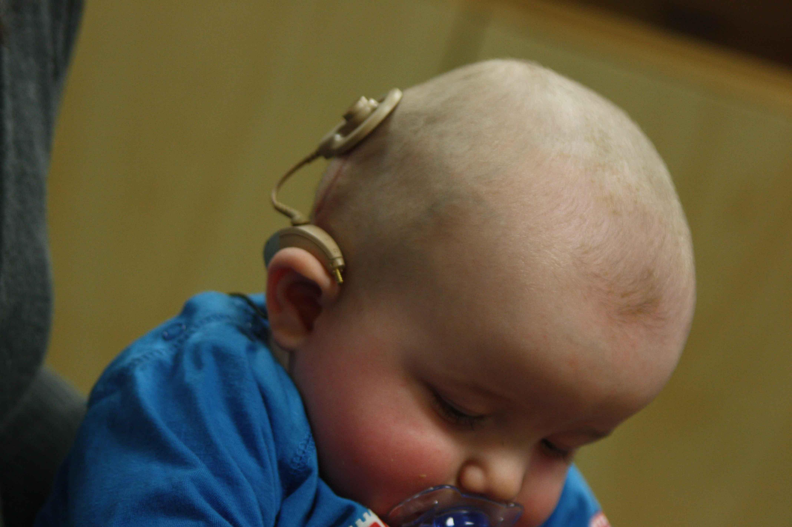
9.21.16… page 36,37,38
A company wants to redesign warning flares. After the company thinks of ideas, what is the best choice for the next step of the engineering design process?
a. Build a prototype
b. Improve the product
c. Decide on the best improvement
d. Define the problem
After the company thinks of ideas they should….
Which of the following is an example of adaptive bioengineering?
A. eyeglasses
b. Hearing aid
c. Crutch
d. Cochlear implant
2. An example of adaptive bioengineering is…

Slide 10
9.22.26
Objective: Students will demonstrate their understanding of dichotomous keys.
Take out:
-half sheet of paper for your quiz
-How to use dichotomous keys
- Chapter 2 outline

Slide 11
Lab tools
Graduated cylinder
Ruler
Stopwatch
Thermometer
Balance
Spring scale

Slide 12
9.23.16
Training Camp List
Unit Test- Look at grade and Write on the My data table…p. 14
Section Page
Vocabulary section 1
Test Retakes
Notes
Daily work will return Monday

