Slide 1
Daily Work
October 10 through October 14

Slide 2
Monday October 10, 2016
Success Criteria:
I will be able to list the eight levels of classification in order from the broadest level to the simplest level
I will be able to distinguish between the 4 kingdoms in the domain eukarya
Science Stems
Daily Work
Domain and Kingdoms presentation and foldable

Slide 3
Daily Work 10-10-16
Remember to write all of your answers with complete sentences ☺
List the 8 levels of classification in order.
The eight levels of classification (from the broadest level to the simplest level) are
The scientific name for the common house cat is Felis domesticus. What is its specific name?
Felis
domesticus
House cat
Feline
2. The specific name for the common house cat is…
What is the name of the procedure that we used to write the scientific name of organisms? (hint: Linneaus created this system)
3. The process we use to write the scientific name of organisms is…

Slide 4
Tuesday October 11, 2016
Success Criteria:
I will be able to explain the difference between the four kingdoms.
I will be able to create a dichotomous key
Daily Work
Domains and Kingdoms foldable
Create dichotomous key

Slide 5
Domains Concept Map…P. 50 10.11.16
Living Things
Word Bank
•Prokaryote
•Eukaryote
•Unicellular only
•Unicellular or Multicellular
•Has a nucleus
•No nucleus
•Found everywhere
•Found in extreme environments
•Includes four Kingdoms
Domain
Archaea
Domain
Bacteria
Domain
Eukarya
*******You can use your foldable and science book pages 55 and 56 to help you***********

Slide 6
Compare Domains
Living Things
Domain
Archaea
Domain
Bacteria
Domain
Eukarya
Prokaryote
Prokaryote
Eukaryote
Unicellular only
Unicellular only
Uni- or Multicellular
No nucleus
No nucleus
Has a nucleus
Found in extreme environments
Found everywhere
Found everywhere
Includes four Kingdoms

Slide 7
10.12.16
Success Criteria
I will be able to say the eight levels of classification in order.
I will be able to create a dichotomous key.
I will be able to explain the difference between the four kingdoms.
Itinerary…
Number your composition book pages 51-100
Update table of contents
Write the weird fact on page 40
Daily Work
Four kingdoms conversation
Create a dichotomous key

Slide 8
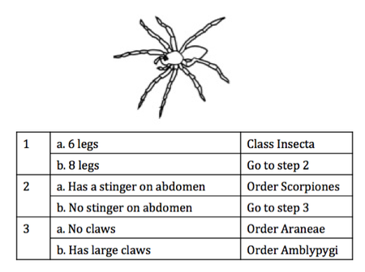
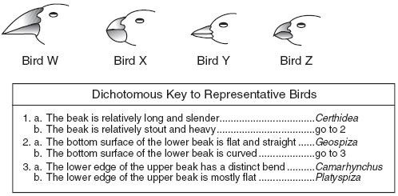
Dichotomous Keys Practice 10.12.16…P.51
What is the name of bird W?
What is the name of bird Z?
Write the eight levels of classification.
1. Identify the following organism:
Bird W is….
Bird Z is …..
The eight levels of classification are…
1. The organism is …..

Slide 9
Eight levels of classification Tricks
DKPCOFGS
Did king Philip come over from Greenland swiftly?
Did Katy Perry carry original frozen grape soda?
Kingdom, phylum, class, order, family, genus

Slide 10
How well do you know the four kingdoms?
Use your foldable to quiz your neighbor.
You have 4 minutes.

Slide 11
Quick Quiz
Word bank: Bacteria, Archaea, Protista, Fungi, Plantae, Animalia
Uses photosynthesis to make food, usually green.
Complex organisms, specialized sense organs, can move around.
No nucleus, simple organisms that can be found in the body
Unicellular organisms that live in extreme environments
Sucks up nutrients with fake roots: mushrooms
Single celled eukaryotes, pond algae
7. Write the eight levels of classification in order from the broadest level to the simplest level

Slide 12
10.13.16
Success Criteria
I will be able to say the 8 levels of classification
I will be able to create a dichotomous key
I will be able to explain the difference between the four kingdoms
Daily Work
How to make a dichotomous key

Slide 13
Photosynthesis, usually green
Domain eukaryote
Sense organs, mobile
Plant kingdom
Animal Kingdom
Fungi Kingdom
Protista kingdom
Unicellular, but complex
Decomposers, uses fake roots
Copy and complete the following diagram on page 51.
___
___
___
___
___
___
___
___
___
Example: Example: Example: Example:

Slide 15
Photosynthesis, usually green
X Domain eukaryote
Sense organs, mobile
X Plant kingdom
X Animal Kingdom
X Fungi Kingdom
X Protista kingdom
Unicellular, but complex
Decomposers, uses fake roots
Copy and complete the following diagram on page 51.
Eukaryotes___
___Protista
___Fungi
__Plantae_
Animalia___
___Unicellular, but complex
___uses fake roots to suck nutrients
_Photosynthesis, usually green
___Sense organs, mobile
Example: diatom, pond algae Example: yeast, mushrooms Example: Flowers Example: Sea Star

Slide 16
10.14.16
Success Criteria
I will be able to tell a neighbor the 8 levels of classification.
I will be able to create a dichotomous key.
I will be able to complete a neighbor’s dichotomous key.
Itinerary:
Take out your “How to make a Dichotomous Key” handout

