Slide 1
Daily Work
9.26.16-9.30.16

Slide 2
9.26.16
Objectives:
1. I can demonstrate an understanding of dichotomous keys
2. I can list the levels of classification from the broadest to the simplest level.
Science Stems
Daily Work
Dichotomous key quiz
Section page, section 1 vocabulary, finish other work
How to use dichotomous keys worksheet
Classification notes

Slide 3
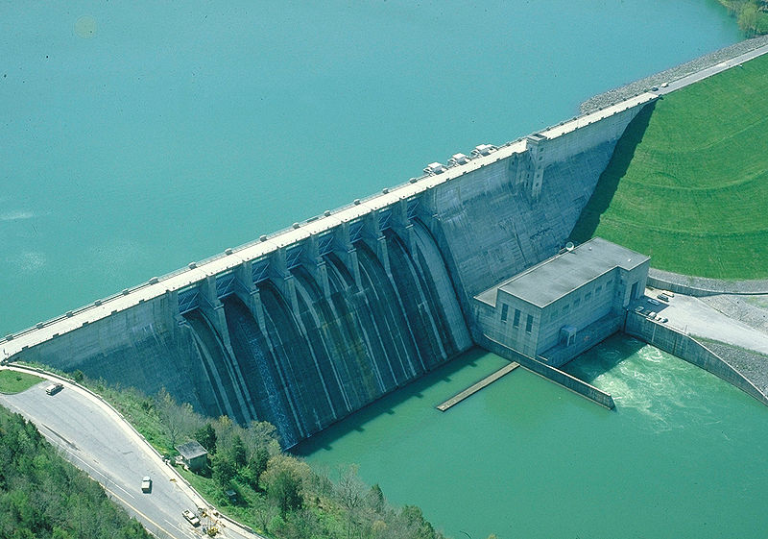
9.26.16
Page 47
A student is to determine how much salt will dissolve in 59 mL of water. Which tool is best for measuring the volume of water being used?
100 mL graduated cylinder
Thermometer
Spring scale
25-mL beaker
1. The best lab tool for measuring 59 mL of water would be….
Which of these is most likely an unintended consequence of building a dam on a river to generate hydroelectric energy?
Less greenhouse gases in the atmosphere
More electricity available for consumers
Lower energy prices for surrounding community
Disturbing the life cycles of certain types of fish
2. The unintended consequence of building a dam on a river to generate hydroelectric energy is…

Slide 4
9.27.16…p 47…write your answers with complete sentences
Think about the different ways humans classify things.
List five groups of things that humans classify, such as library books, food in Wal-Mart, and addresses.
What happens when you put something in the wrong group?
Can objects or ideas belong in more than one group at the same time?
How do we classify variables in an experiment?
How do we classify bioengineering technology?

Slide 5
9.28.16
Weird Fact
Daily Work
Finish Notes
Chapter outline p44
Friday is BYOD….for research ☺
Test tomorrow

Slide 6
9.29.16
Graphic Organizer (Concept Map)….p. 48
Test
Foldable

Slide 7
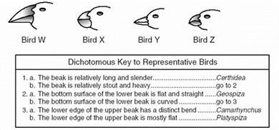

Slide 8
9.30.16
Success criteria
I can…. List the characteristics of each of the three domains
I can…create a branching diagram and a dichotomous key
Unit Test 2 page….49
Record your grade on the Chapter 2 column on page 14
Go over the test
Foldable
Organism Project

Slide 9
Organism Project
List the levels of classification for each organism.
Look up the history of the organisms, and determine when they emerged. Use this information to make a branching diagram for your organisms. Include any significant characteristics.
Look at the characteristics of your organisms. Use the characteristics to create a dichotomous key.
Include sketches of your organisms

Slide 10
Organisms groups
Domain Eukarya: Kingdom: Animalia 1 | Domain Eukarya: Kingdom: Animalia 2 | Domain Eukarya: Kingdom: Animalia 3 | Domain Eukarya: Kingdom: Plantae 4 | Domain Eukarya: Kingdom: Plantae 5 | Domain Eukarya: Kingdom: Fungi 6 | Domain Eukarya: Kingdom: Protista 7 | Domain Eukarya: Kingdom: Animalia 8
Sea sponges- | Mullosks | Hagfish | Green algae | Ferns | Water molds | Amoeba | Sauropods
Jelly fish | Earthworms | sharks | Brown algae | Conifers | Bread molds | Euglena | Allosaurus
Roundworms | Sea stars | Frogs | Liverworts | Gingko | mushrooms | Dinoflagellate | Tyrannosaurus
crabs | Birds | Crocodiles | mosses | Monocots | Yeast | Paramecium | Birds

Slide 11
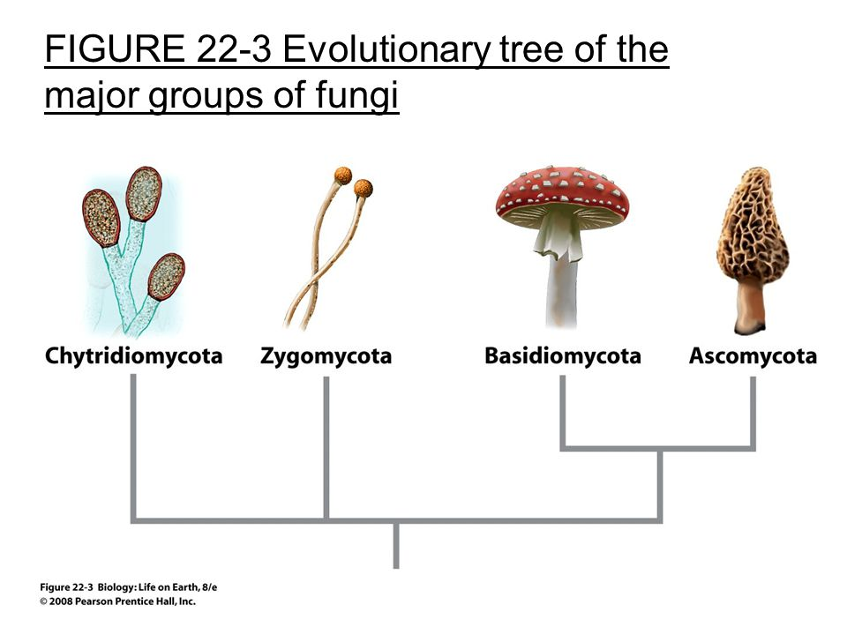

Slide 12
